Slide 1
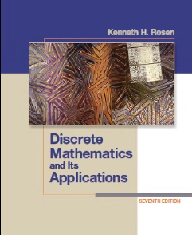
CSE 101: Discrete Mathematics
Slide 07
Mathematical Induction
Department of Computer Science and Engineering(CSE)
Green University of Bangladesh(GUB)
Notes:
‹#›

Slide 2
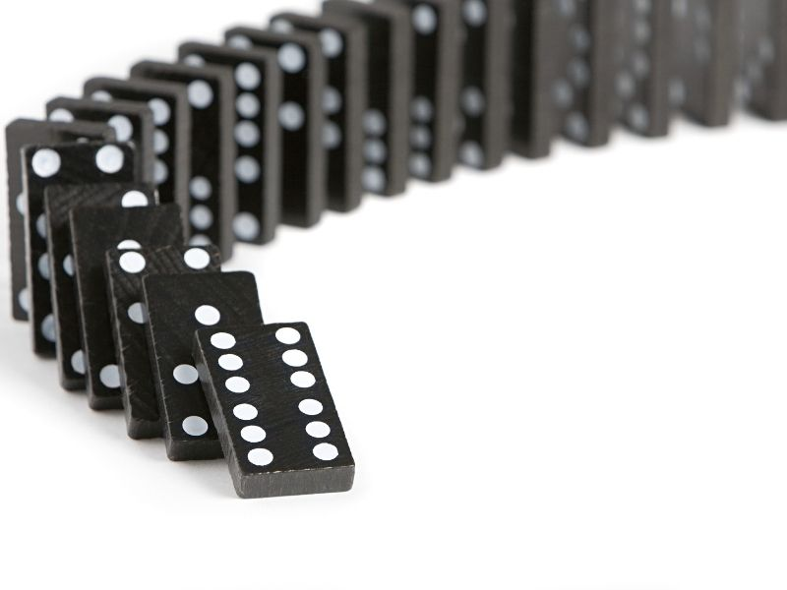
Mathematical Induction
So sequence of propositions is a sequence of dominos.

Slide 3

Mathematical Induction
So sequence of propositions is a sequence of dominos.
P (0)
P (1)
P (2)
P (n)
P (n+1)
…

Slide 4
Mathematical Induction
Then can conclude that all the dominos fall!
P (0)
P (1)
P (2)
P (n)
P (n+1)
…

Slide 5


Mathematical Induction
Then can conclude that all the dominos fall!
P (1)
P (2)
P (n)
P (n+1)
P (0)
true
…

Slide 6
Mathematical Induction
Then can conclude that all the dominos fall!
P (2)
P (n)
P (n+1)
P (0)
true
P (1)
true
…

Slide 7
Mathematical Induction
Then can conclude that all the dominos fall!
P (n)
P (n+1)
P (0)
true
P (1)
true
P (2)
true
…

Slide 8
Mathematical Induction
Then can conclude that all the dominos fall!
P (n)
P (n+1)
P (0)
true
P (1)
true
P (2)
true
…

Slide 9
Mathematical Induction
Then can conclude that all the dominos fall!
P (n+1)
P (0)
true
P (1)
true
P (2)
true
…
P (n)
true

Slide 10
Mathematical Induction
Then can conclude that all the dominos fall!
P (0)
true
P (1)
true
P (2)
true
…
P (n)
true
P (n+1)
true

Slide 11
Proof Technique
Mathematical induction is a technique that can be applied to prove the universal statements for sets of positive integers or their associated sequences.
Notes:
‹#›
Book typically starts with n=1 instead of n=0. Starting point is arbitrary.

Slide 12
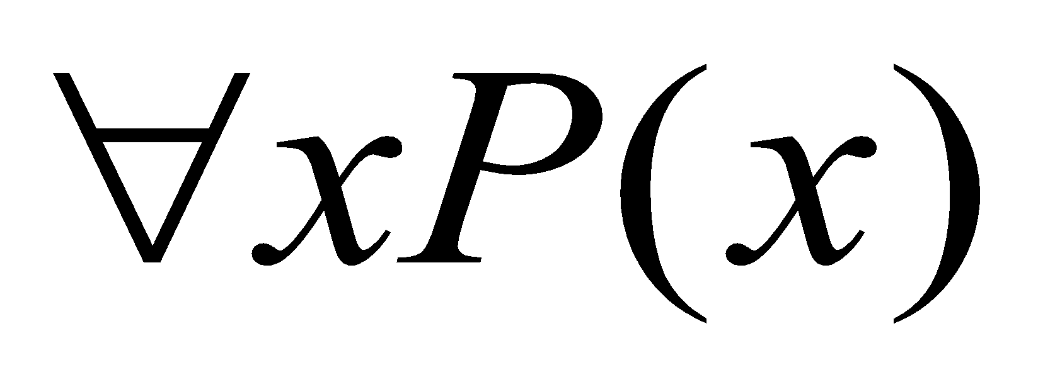
Mathematical Induction
Step 1 (Basis Step): Show that P(a) is true.
Step 2 (Induction Step): Show that for all integers k>=a,
if P(k) is true then P(k+1) is true.
Used to prove statements of the form where x ϵ Z+
Mathematical induction proofs consists of two steps:
1) Basis Step: The proposition P(1) is true.
2) Inductive Step: The implication
P(n) → P(n+1), is true for all positive n.
• Therefore we conclude
Notes:
‹#›
Book typically starts with n=1 instead of n=0. Starting point is arbitrary.

Slide 13
Mathematical Induction
Example: Prove that, 1+2+3+....+n = n(n+1)/2 , for n belongs to Z, n>=1
Solution:
Step 1 (Basis Step): P(1) is true as 1 = 1(1+1)/2 = 1.
Step 2 (Induction Step):
Assume, 1 + 2 + 3 + … + k = k(k+1)/2 is true. (Induction Hypothesis)
Now, We need to prove,
1 + 2 + 3 + … + (k+1) = (k+1)(k+2)/2. (replacing n with k +1)
1 + 2 + 3 + … + k + (k+1) = (k+1)(k+2)/2
k(k+1)/2 + (k+1) = (k+1)(k+2)/2
(k² + k)/2 + k + 1 = (k² + 2k + k + 2)/2
(k² + 2k + k + 2)/2 = (k² + 2k + k + 2)/2
PROVED
Notes:
‹#›
Book typically starts with n=1 instead of n=0. Starting point is arbitrary.

Slide 14
Mathematical Induction
Example: Prove the sum of first n odd integers is n² .
i.e. 1 + 3 + 5 + 7 + ... + (2n - 1) = n² for all positive integers.
Proof:
What is P(n)?
P(n): 1 + 3 + 5 + 7 + ... + (2n - 1) = n²
Notes:
‹#›
Book typically starts with n=1 instead of n=0. Starting point is arbitrary.

Slide 15
Mathematical Induction Example.
Geometric interpretation. To get next square, need to add next odd number:

Slide 16
Mathematical Induction Example.
Geometric interpretation. To get next square, need to add next odd number:
1

Slide 17
Mathematical Induction Example.
Geometric interpretation. To get next square, need to add next odd number:
1+3

Slide 18
Mathematical Induction Example.
Geometric interpretation. To get next square, need to add next odd number:
1+3+5

Slide 19
Mathematical Induction Example.
Geometric interpretation. To get next square, need to add next odd number:
1+3+5+7

Slide 20
Mathematical Induction Example.
Geometric interpretation. To get next square, need to add next odd number:
1+3+5+7+9

Slide 21
Mathematical Induction Example.
Geometric interpretation. To get next square, need to add next odd number:
1+3+5+7+9 +11

Slide 22
Mathematical Induction Example.
Geometric interpretation. To get next square, need to add next odd number:
1+3+5+7+9 +11+13

Slide 23
Mathematical Induction Example.
Geometric interpretation. To get next square, need to add next odd number:
1+3+5+7+9+11+13=7²

Slide 24
Mathematical Induction
Basis Step Show P(1) is true
1 = 1²
Inductive Step
Show if P(k) is true then P(k+1) is true for all n.
Suppose P(k) is true,
that is 1 + 3 + 5 + 7 + ... + (2k - 1) = k²
Show P(k+1):
1 + 3 + 5 + 7 + ... + (2k - 1) + (2k + 1) = (k+1)²
follows:
1 + 3 + 5 + 7 + ... + (2k - 1) + (2k + 1) = k² + (2k+1) = (k+1)²
Notes:
‹#›
Book typically starts with n=1 instead of n=0. Starting point is arbitrary.

Slide 25
Mathematical Induction
Example: Prove n³ - n is divisible by 3 for all positive integers.
P(n): n³ - n is divisible by 3
Basis Step: P(1): 1³ - 1 = 0 is divisible by 3
Inductive Step: If P(n) is true then P(n+1) is true for each positive integer.
Suppose P(n): n³ - n is divisible by 3 is true.
Show P(n+1): (n+1)³ - (n+1) is divisible by 3.
(n+1)³ - (n+1) = n³ + 3n² + 3n + 1 - n - 1
= (n³ - n) + 3n² + 3n
= (n³ - n) + 3(n² + n)
Divisible by 3
Divisible by 3
Notes:
‹#›
Book typically starts with n=1 instead of n=0. Starting point is arbitrary.

Slide 26
Mathematical Induction
Example: Prove that 2^{n} < n! for all n ≥ 4.
Basis Step: P(4) = 2⁴ < 4! =16 < 24 (true)
Inductive Step:
If P(n) is true then P(n+1) is also true: We need to show: 2^{n+1} < (n+1)!
2^{n+1} = 2 . 2^{n}
2^{n+1} = 2 . 2^{n} < 2. n! (we assumed 2^{n} < n! )
2^{n+1} = 2 . 2^{n} < (n+1)n! (2<n+1)
2^{n+1} = 2 . 2^{n} < (n+1)!
PROVED
Notes:
‹#›
Book typically starts with n=1 instead of n=0. Starting point is arbitrary.

Slide 27
Strong Induction
The regular induction:
– basis step P(1) and
– inductive step P(n-1) → P(n)
• Strong induction uses:
– basis step P(1) and
– inductive step P(1) and P(2) … P(n-2) and P(n-1) → P(n)
Example: Show that a positive integer greater than 1 can be written as a product of primes.
Notes:
‹#›
Book typically starts with n=1 instead of n=0. Starting point is arbitrary.

Slide 28
Strong Induction
Show that a positive integer greater than 1 can be written as a product of primes.
Basis step: P(2) is true
Inductive step: Assume true for P(2), P(3), … P(n)
Show that P(n+1) is true as well.
2 Cases:
If n+1 is a prime then P(n+1) is trivially true
If n+1 is a composite then it can be written as a product of two integers (n+1) = a*b such that 1< a ,b < n+1
From the assumption P(a) and P(b) holds.
• Thus, n+1 can be written as a product of primes
• End of proof
Notes:
‹#›
Book typically starts with n=1 instead of n=0. Starting point is arbitrary.

Slide 29
Book References
Chapter 5 (Page 311)
Problem (3, 4, 5, 7, 12, 13, 15, 16, 17, 18) (Page-329)
Notes:
‹#›

Slide 30
Thank You

